Slide 1
Data Normalization
Understanding when and why to normalize your data

Slide 2
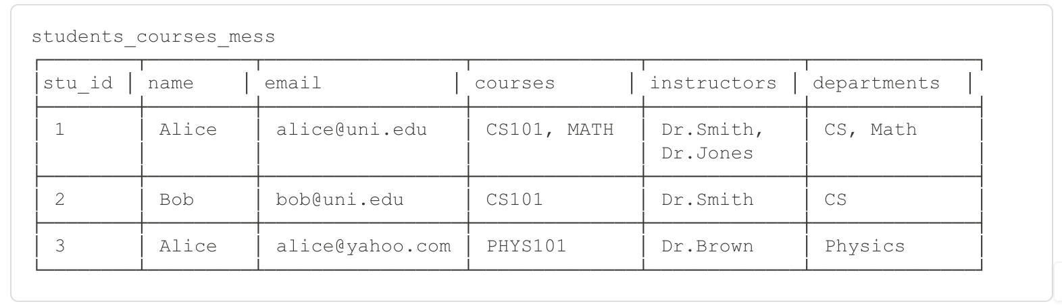
The Mess We're Trying to Avoid
What problems do you see?

Slide 3
The Core Problems
1. INSERT ANOMALY
Problem: Can't add a course unless someone enrolls
Example: New course "CS102" exists, but no students yet
→ Can't insert into table!
2. UPDATE ANOMALY
Problem: Update data in multiple places
Example: Dr. Smith changes name to Dr. Smith-Johnson
→ Must update every row mentioning them
→ Risk of inconsistency if we miss some
3. DELETE ANOMALY
Problem: Deleting one thing deletes unrelated data
Example: Bob drops CS101 (last student)
→ Lose all info about CS101 existing!
4. REDUNDANCY
Problem: Same data stored multiple times
Example: "CS Department" repeated 100 times
→ Wasted space, inconsistency risk

Slide 4
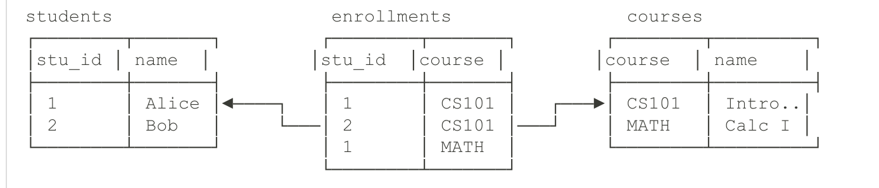
Normalized Version (Simplified)

Slide 5
Benefits
✅ Each fact stored once
✅ Can add course without students
✅ Update instructor name once
✅ Delete student without losing course
"Normalization = organizing data to avoid anomalies"

Slide 6
Understanding Keys
PRIMARY KEY (PK):
Uniquely identifies each row
Example: student_id
CANDIDATE KEY:
Any column(s) that COULD be primary key
Example: student_id, email (both unique)
COMPOSITE KEY:
Primary key made of multiple columns
Example: (student_id, course_id) for enrollment
FOREIGN KEY (FK):
References primary key in another table
Example: student_id in enrollments → students.student_id
FUNCTIONAL DEPENDENCY:
A → B means "A determines B"
Example: student_id → name
(knowing student_id tells you the name)

Slide 7
The Normal Forms
5NF ─────► Very Rare
4NF ─────► Rare
BCNF ────► Advanced
3NF ─────► Target for most apps ⭐
2NF ─────► Intermediate
1NF ─────► Minimum requirement
Unnormalized ────► Starting point

Slide 8
First Normal Form (1NF)
Rule: "Atomic values only - no lists, no repeating groups”
-- ❌ VIOLATES 1NF
CREATE TABLE students (
student_id INT,
name VARCHAR(100),
courses VARCHAR(500) -- "CS101, MATH, PHYS101" ← Multiple values!
Unbounded
);

Slide 9
First Normal Form (1NF)
-- ✅ SATISFIES 1NF
CREATE TABLE students (
student_id INT PRIMARY KEY,
name VARCHAR(100)
);
CREATE TABLE enrollments (
student_id INT,
course_id VARCHAR(10),
PRIMARY KEY (student_id, course_id)
);

Slide 10
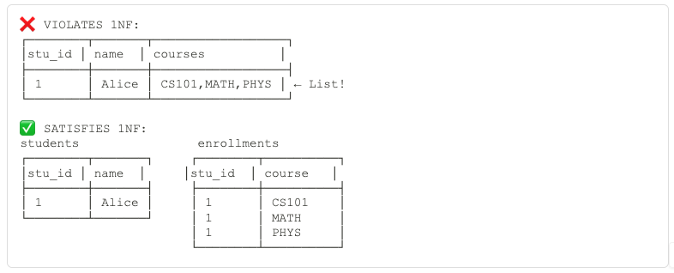
First Normal Form (1NF)
Key Takeaway: "Each cell should contain ONE value"

Slide 11
Second Normal Form (2NF)
Rule: "No partial dependencies on composite keys"
Prerequisite: Must be in 1NF first
-- Composite key: (student_id, course_id)
CREATE TABLE enrollments (
student_id INT,
course_id VARCHAR(10),
student_name VARCHAR(100), -- ❌ Depends only on student_id!
course_name VARCHAR(100), -- ❌ Depends only on course_id!
grade CHAR(1), -- ✅ Depends on both
PRIMARY KEY (student_id, course_id)
);

Slide 12
Second Normal Form (2NF)
-- ✅ SATISFIES 2NF
CREATE TABLE students (
student_id INT PRIMARY KEY,
student_name VARCHAR(100)
);
CREATE TABLE courses (
course_id VARCHAR(10) PRIMARY KEY,
course_name VARCHAR(100)
);
CREATE TABLE enrollments (
student_id INT,
course_id VARCHAR(10),
grade CHAR(1), -- Only attributes that depend on FULL key
PRIMARY KEY (student_id, course_id),
FOREIGN KEY (student_id) REFERENCES students(student_id),
FOREIGN KEY (course_id) REFERENCES courses(course_id)
);

Slide 13
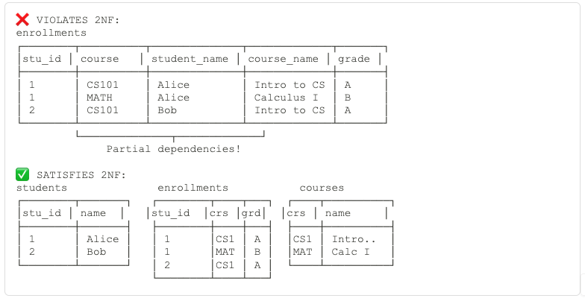
Second Normal Form (2NF)
Key Takeaway: "Non-key columns must depend on the WHOLE key"

Slide 14
Third Normal Form (3NF)
Rule: "No transitive dependencies"
Definition: A → B → C (C depends on A through B)
CREATE TABLE students (
student_id INT PRIMARY KEY,
name VARCHAR(100),
dept_id INT,
dept_name VARCHAR(100), -- ❌ Transitive dependency!
dept_building VARCHAR(100) -- ❌ Transitive dependency!
);
student_id → dept_id → dept_name
student_id → dept_id → dept_building

Slide 15
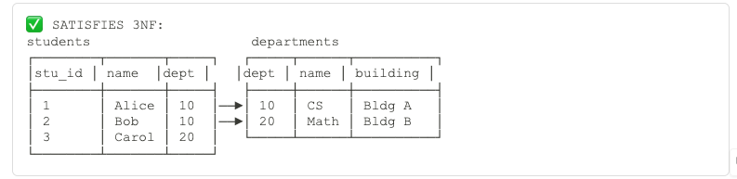
Third Normal Form (3NF)
Key Takeaway: "Non-key columns must depend ONLY on the key, not on other non-key columns"

Slide 16
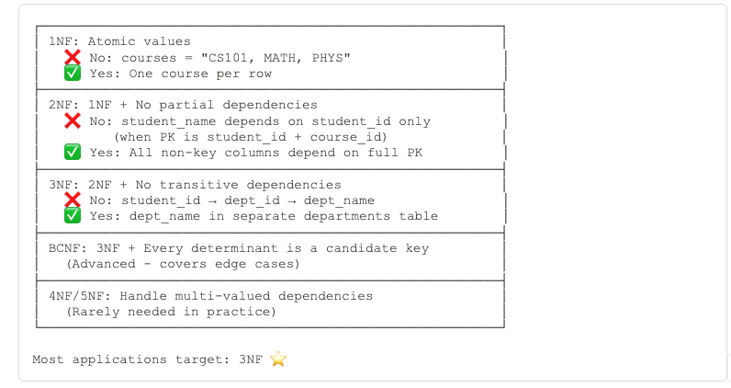
The Normal Forms Cheat Sheet

Slide 17
BCNF (Boyce-Codd Normal Form)
Rule: "Every determinant must be a candidate key”

Slide 18
BCNF (Boyce-Codd Normal Form)
-- Example: Course scheduling
CREATE TABLE teaching (
professor VARCHAR(100),
course VARCHAR(100),
textbook VARCHAR(100),
PRIMARY KEY (professor, course)
);
-- Constraint: Each course uses only one textbook
-- course → textbook (but course is not a candidate key!)
Dependencies:
(professor, course) → textbook ✅
course → textbook ❌ course alone determines textbook
but course is NOT a candidate key!
Notes:
What assumptions we are making here?

Slide 19
When Normalization Hurts Performance
-- Normalized (3NF):
SELECT
s.name,
c.course_name,
i.instructor_name,
d.dept_name
FROM students s
JOIN enrollments e ON s.student_id = e.student_id
JOIN courses c ON e.course_id = c.course_id
JOIN instructors i ON c.instructor_id = i.instructor_id
JOIN departments d ON i.dept_id = d.dept_id
WHERE s.student_id = 1;
-- 4 JOINs needed! 😰
-- Denormalized:
SELECT
name,
course_name,
instructor_name,
dept_name
FROM student_course_view
WHERE student_id = 1;
-- No JOINs! 🎉
-- But: Data duplication, update complexity
Notes:
What is student_course_view?

Slide 20
When Normalization Hurts Performance
Normalized (3NF):
Create view student_course_view as (
SELECT
s.name,
c.course_name,
i.instructor_name,
d.dept_name
FROM students s
JOIN enrollments e ON s.student_id = e.student_id
JOIN courses c ON e.course_id = c.course_id
JOIN instructors i ON c.instructor_id = i.instructor_id
JOIN departments d ON i.dept_id = d.dept_id
)
-- 4 JOINs needed! 😰
-- Denormalized:
SELECT
name,
course_name,
instructor_name,
dept_name
FROM student_course_view
WHERE student_id = 1;
-- No JOINs! 🎉
-- But: Data duplication, update complexity
Notes:
What is student_course_view?

Slide 21
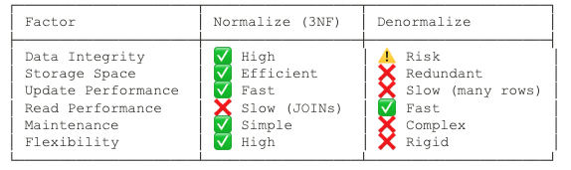
Normalization vs Denormalization Decision Matrix

Slide 22
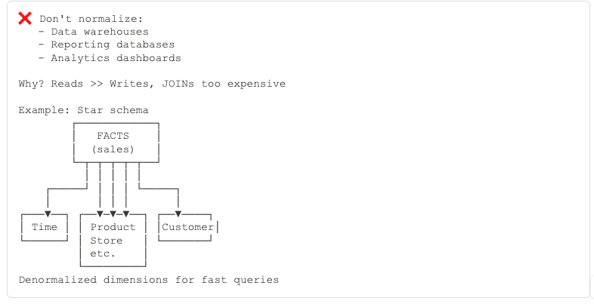
When to Denormalize - Real Scenarios
Read-Heavy Analytics

Slide 23
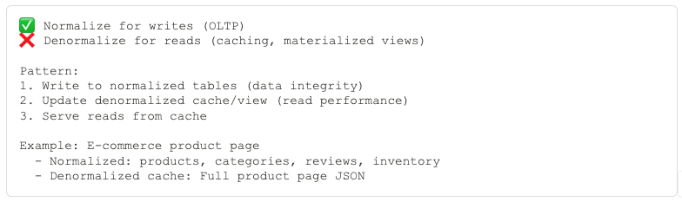
When to Denormalize - Real Scenarios
High-Traffic Web Apps

Slide 24
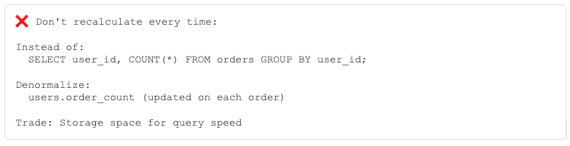
When to Denormalize - Real Scenarios
Aggregated Data

Slide 25
Partial Denormalization Strategies
Computed Columns
-- Normalized base tables
CREATE TABLE order_items (
order_id INT,
product_id INT,
quantity INT,
unit_price DECIMAL(10,2)
);
-- Denormalized aggregate
CREATE TABLE orders (
order_id INT PRIMARY KEY,
customer_id INT,
total_amount DECIMAL(10,2), -- ← Denormalized (sum of items)
item_count INT -- ← Denormalized (count of items)
);
-- Maintain with triggers or application logic

Slide 26
Partial Denormalization Strategies
Materialized Views
-- Normalized source
CREATE VIEW student_report AS
SELECT
s.student_id,
s.name,
COUNT(e.course_id) as course_count,
AVG(e.grade) as gpa
FROM students s
LEFT JOIN enrollments e
ON s.student_id = e.student_id
GROUP BY s.student_id, s.name;
-- Materialize for performance
CREATE MATERIALIZED VIEW student_report_cache AS
SELECT * FROM student_report;
-- Refresh periodically
REFRESH MATERIALIZED VIEW student_report_cache;

Slide 27
Partial Denormalization Strategies
Selective Duplication
-- Duplicate frequently-accessed data only
CREATE TABLE orders (
order_id INT PRIMARY KEY,
customer_id INT,
customer_name VARCHAR(100), -- ← Duplicated for display
customer_email VARCHAR(100), -- ← Duplicated for emails
-- Don't duplicate address, phone, etc.
FOREIGN KEY (customer_id) REFERENCES customers(customer_id)
);
-- Write: Update both places
-- Read: Fast (no JOIN for common case)

Slide 28
NoSQL
Reference when:
  1. Data changes independently
  2. Data used in many contexts
  3. Document size would be too large (>16MB)

Slide 29
Tools and Techniques
1. Database Features:
✅ Triggers (auto-update derived data)
✅ Materialized views (pre-computed JOINs)
✅ Generated columns (computed values)
✅ JSON columns (flexible schema in SQL)
2. Application Patterns:
✅ Repository pattern (encapsulate updates)
✅ Event sourcing (rebuild views from events)
✅ Cache-aside pattern (lazy load cache)
✅ Write-through cache (eager update)
3. Infrastructure:
✅ CDC tools (Debezium, Maxwell)
✅ Stream processing (Kafka, Flink)
✅ Search engines (Elasticsearch)
✅ Caching layers (Redis, Memcached)

